Slide 1
Evaluating Machine Learning Classifiers: Accuracy, Precision and Recall
Scott O’Hara
Metrowest Developers Machine Learning Group
11/20/2019

Slide 2
References
Applied Machine Learning in Python
University of Michigan, Prof. Kevin Collins Thompson (AMLP)
https://www.coursera.org/learn/python-machine-learning/home/welcome
Machine Learning: Classification
University of Washington, Profs. Emily Fox & Carlos Guestrin (MLC)
https://www.coursera.org/learn/ml-regression/home/welcome

Slide 3
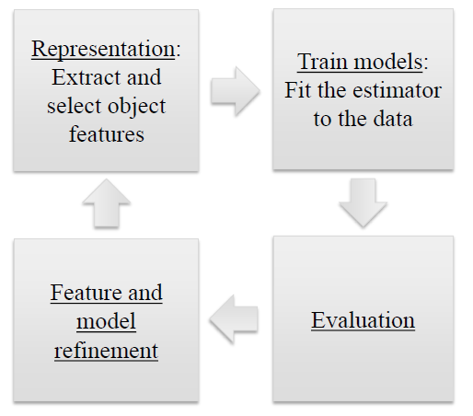
Represent, Train, Evaluate, Refine

Slide 4

Accuracy is a Common Metric
$$Accuracy= \frac{\# of correct predictions}{\# of total instances}$$
A model with 99.9% accuracy can sound really good!

Slide 5
HOWEVER, Consider Imbalanced Classes
Suppose you have two classes:
Relevant (R): the positive class
Not_Relevant (N): the negative class
Out of 1000 randomly selected items, on average
1 item is relevant
999 items are not relevant

Slide 6

A Dummy Classifier gets 99.9% Accuracy!
Classifier always predicts N
Out of 1000 randomly selected items:
$$Accuracy= \frac{999}{1000}=99.9\%$$

Slide 7
Dummy classifiers completely ignore input data
Dummy classifiers can serve as a sanity check on your classifier’s performance.
Some commonly-used dummy classifiers:
most-frequent: predict most frequent label in training set.
stratified: random prediction based on training set distribution
uniform: choose predictions from a uniform probability distribution.
constant: predict constant label given by user.

Slide 8
precision and recall
Different applications have different goals. Accuracy is widely used, but many other metrics are possible. Two common alternatives to accuracy are: precision and recall.
PRECISION: fraction of positive predictions that are actually positive.
RECALL: fraction of positive examples that are predicted to be positive.

Slide 9
domains where precision is important
Search engine rankings, query suggestions
Document classification
Customer-facing tasks, e.g.,:
product recommendation
a restaurant website that automatically selects and posts positive reviews.

Slide 10
domains where RECALL is important
Cancer tumor detection
Search and information extraction in legal discovery.
Often paired with a human expert to filter out false positives.

Slide 11
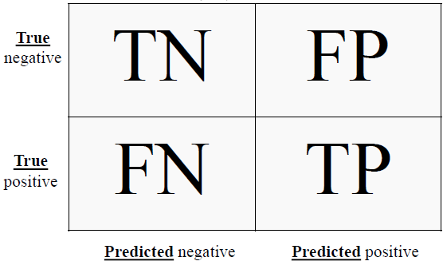
The Confusion Matrix
TP = true positive
FP = false positive
TN = true negative
FN = false negative

Slide 12
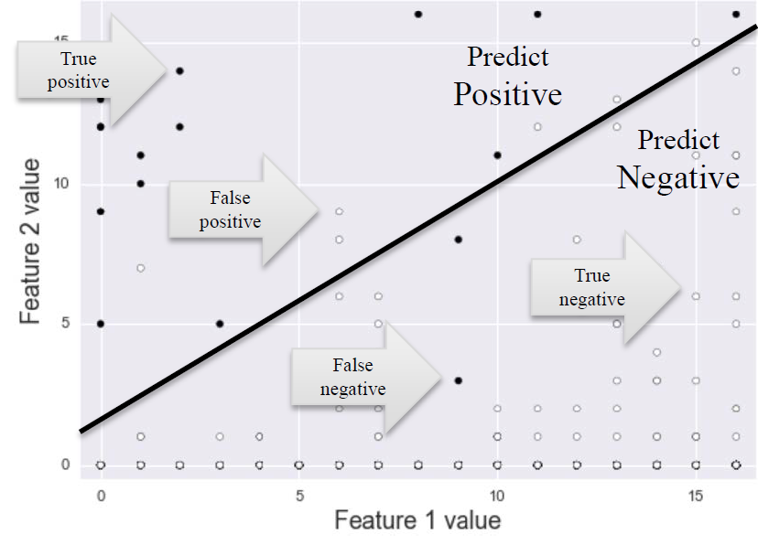
Visualizing different Error Types

Slide 13
The Confusion Matrix
Every test instance is in exactly one box.
Breaks down classifier results by error type (FP vs FN).
Provides more information than simple accuracy.
Helps you choose an evaluation metric that matches your project goals.
There are many possible metrics that can be derived from the confusion matrix.
= 356
= 51
= 38
= 5
N = TN +TP+FN+FP = 450

Slide 14
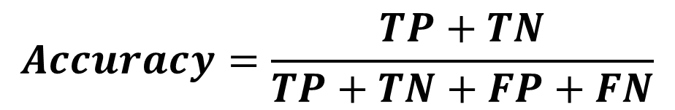
Accuracy
As FN + FP → 0, Accuracy → 1.0
As FN + FP ↑, Accuracy → 0.0
$$Accuracy=\frac{TP+TN}{TP+TN+FP+FN}$$

Slide 15


precision
As FP → 0, Precision → 1.0
As FP ↑, Precision → 0.0
$$Precision=\frac{TP}{TP+FP}$$

Slide 16


RECALL
As FN → 0, Recall → 1.0
As FN ↑, Recall → 0.0
$$Recall=\frac{TP}{TP+FN}$$

Slide 17
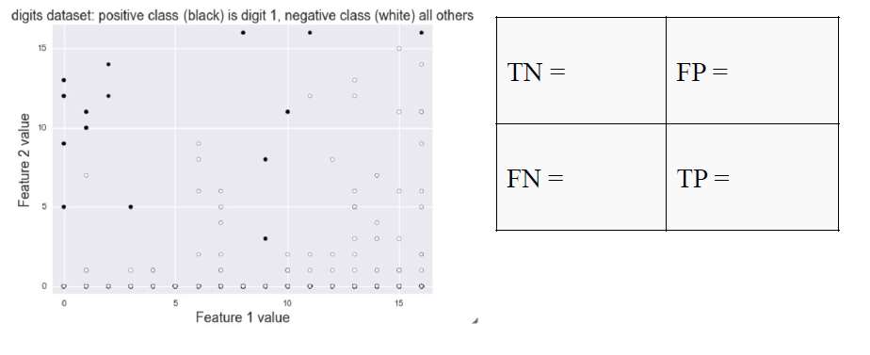
Illustrating Precision & Recall

Slide 18
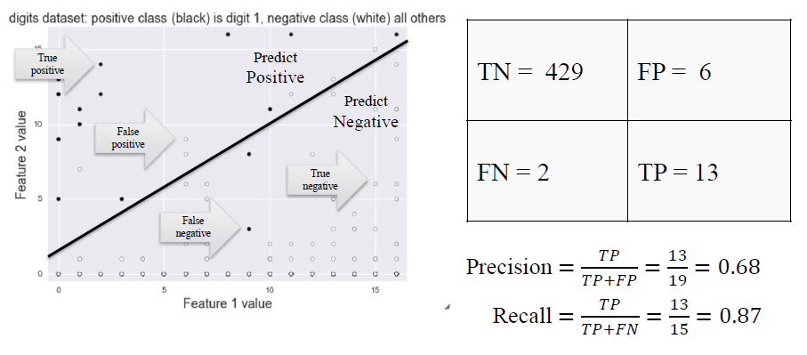
Illustrating Precision & Recall

Slide 19
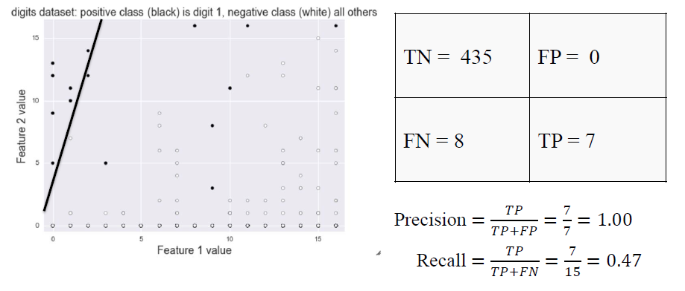

High precision / low recall

Slide 20
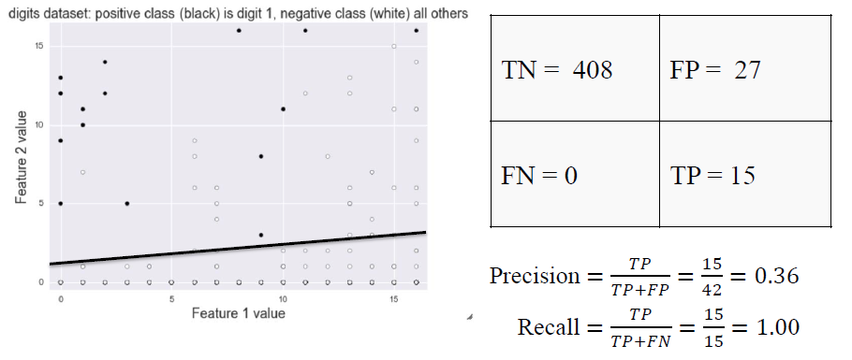

High precision / low recall

Slide 21
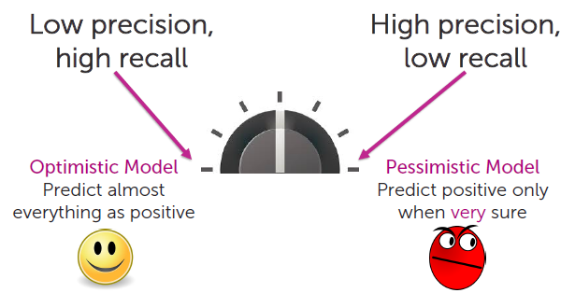
Balancing Precision and recall
Rather than seeking to maximize precision or recall, an optimal balance between the two is often sought.

Slide 22
Decision Functions
A decision function is a classifier that returns a score that represents how confident the classifier is in its prediction.
The decision threshold can be “adjusted” to result in a decision function that exhibits more or less precision or recall.
A higher threshold results in a more “pessimistic” classifier i.e., it increase precision.
A lower threshold results in a more “optimistic” classifier i.e., it increase recall.
By sweeping the decision threshold through the entire range of possible score values, we get a series of classification outcomes that form a curve.

Slide 23
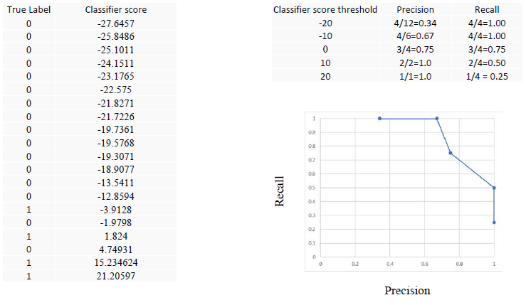
Varying the Decision Threshold

Slide 24
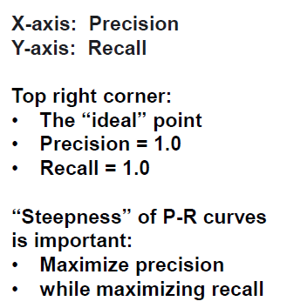
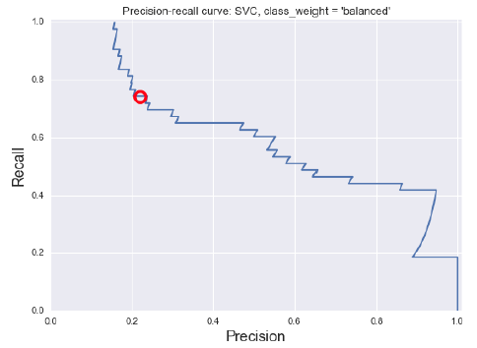
Precision-recall curves

Slide 25
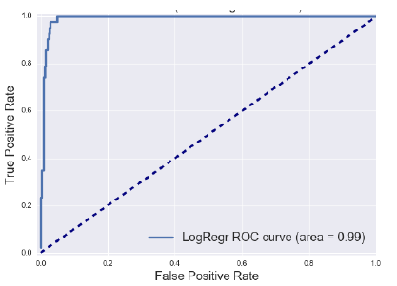
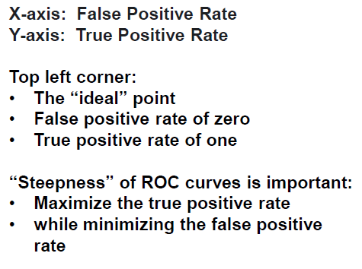
ROC Curves
ROC = Receiver Operating Characteristic

Slide 26
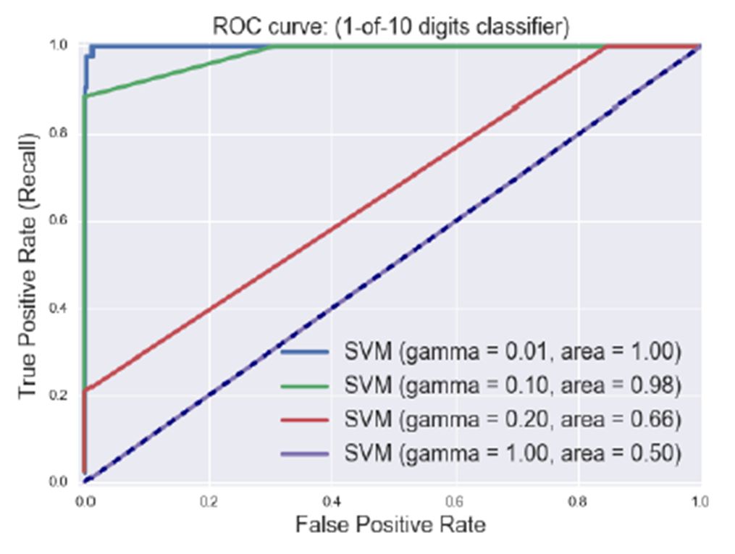
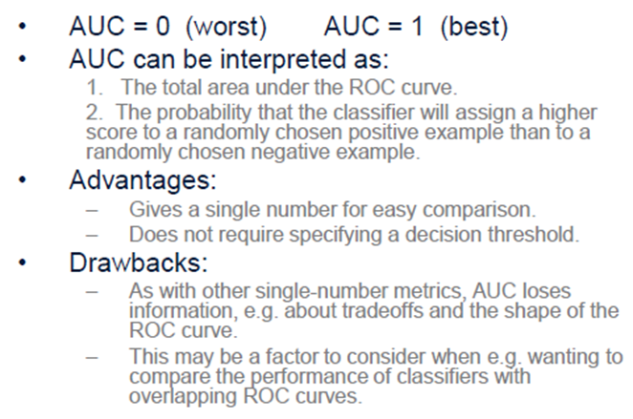
Summarizing an ROC curve in one number: Area Under the Curve (AUC)

Slide 27
Conclusion
Consider carefully the data you have and what you are trying to do with it.
Choose a SINGLE metric and optimize that metric.
If this gives satisfactory results, then you are done. Otherwise return to step 1.

Slide 28
Extra Slides

Slide 29
Probabilistic classifiers
Some classifiers return a probability that an item is a particular class rather than a Boolean value.
Examples include Logistic regression, Naïve Bayes.
Typical rule is choose likely class if P(x) > threshold where threshold > 0.5
Adjusting threshold affects predictions of classifier
Higher threshold results in a more “pessimistic” classifier i.e., it increase precision.

Slide 30
ROC Curves: Random guessing

Slide 31
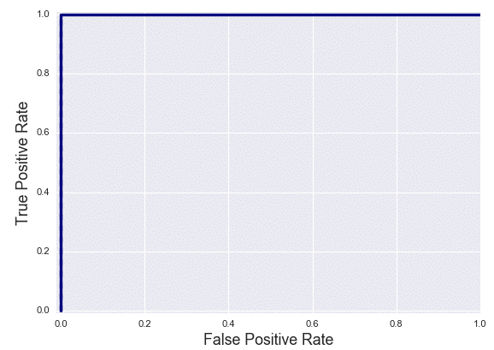
ROC Curves: perfect classifier

Slide 32

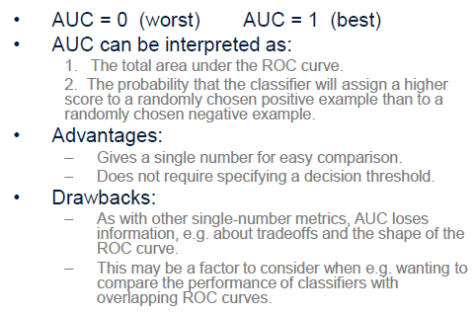
Summarizing an ROC curve in one number: Area Under the Curve (AUC)

Slide 33

The F1-score
The F1-score combines precision and recall into a single number.
The F1-score is the harmonic mean of precision and recall.

Slide 34
The F-score
The F-score is a generalization of the F1-score.
β allows adjustment of the metric to control the emphasis on recall vs precision.
β < 1.0 results in greater precision (minimize false positives)
β > 1.0 results in greater recall (minimize false negatives)

